Slide 1
Hackathon Presentation
By: Aditya Jagdev

Slide 2
Problem Statement
Mahindra First Choice is a chain of multi-brand car workshops which wants to leverage its data to find trends among its workshops and realize improvements.
Carrying out geolocation based customer analysis would help Mahindra First Choice in making a decision as to where and what kind of resources need to be put to increase revenue.
Notes:
Can we include some examples here?

Slide 3
Why solve this problem?
Geolocation based customer analysis will decrease the probablity of making ineffective changes and consequently allow
Why solving this problem is important? - Business Impact
Who are the stakeholders for whom you are presenting the solution? - CEO, CFO, Marketing, Sales etc
Any important assumptions you are making.

Slide 4
Data
The data-set contains the invoices of customers, customer data, the joint technical sheet and a plant master data sheet.
It would have been of further benefit if a much clearer description of the data-sets were provided, due to absence of which data cleaning has taken much of the time.

Slide 5
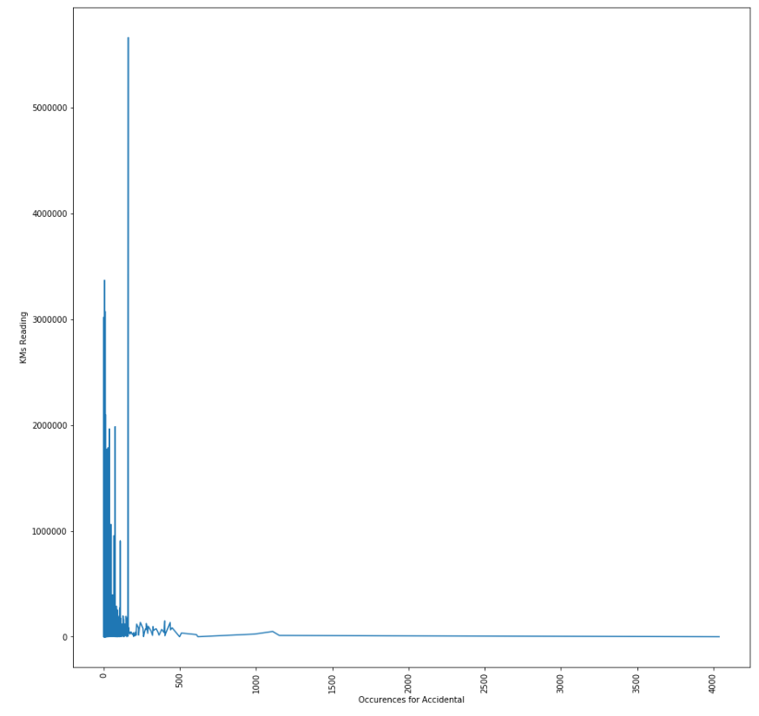
Exploratory Data Analysis
It was interesting to find out that a large portion of repairs are carried out on vehicles with a relatively low KMs reading. This may either mean that drivers get more proficient as they drive or they are reluctant to get the cars repaired once its old.

Slide 6
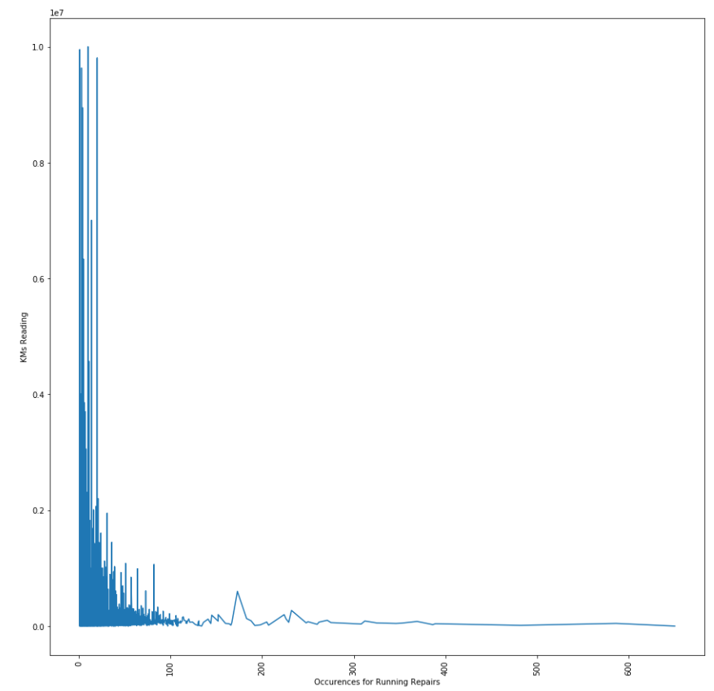
Exploratory Data Analysis
A similar trend was seen in the running repairs type of service where exponentially more cars would come in for running repairs that have a lower KMs reading.

Slide 7
Final Results
So far only data cleaning and basic EDA has been carried out.

Slide 8
Insights & Decisions
The business should be targeted more towards customers with new vehicles as they form a majority.
The business should put in place efforts to reduce the transaction cost of a customer trying to find a service station by simply partnering with automotive dealers to ensure a steady stream of revenue as new vehicles are purchased. This would also allow in predicting the kind of vehicles and their amount that would arrive at a workshop in a span of time.
The business must focus on converting new vehicle owners to their customers. Targeting owners with older vehicles will only lead to reduced returns.

Slide 9
Next Steps
If I had more time, I would have carried out further EDA and used a model to determine the CLT (Customer Lifetime Value) and subsequently sum up customers’ CLT that come to a workshop to obtain the expected revenue wrt time on these workshops.
Furthermore, a metric to measure the number of workshop employees and cars serviced wrt the total value of workshop would return the efficiency of the workshop.

